Slide 1
Notes:
Welcome
In these 5 mins I am going to talk about ACT on it: Mindfulness for Teens
My name’s Reuben. I work for the Melbourne Clinic in Australia as an ACT therapist

Slide 2
Notes:
Steve Hayes:
Teenagers have seen more death (real and fictional), heard more judgments, and witnessed more suffering than many adults in past generations…

Slide 3
Notes:
There’s an increasing amount of youth suicide (this week on ABC Australia - 1 in 5 teens with a mental health problem)
Story begins 2 years ago
I was invited to a workshop for suicidal teens in the north Melbourne suburbs

Slide 4
Share YOUR Gift
Notes:
Knowing the turmoil that these kids had been through, yet seeing them
expressing themselves in ways of their choosing – poetry, music, dancing, story telling etc
Deeply moved by their capacity to move forward

Slide 5
Notes:
I came up with the idea for a FREE app called ACT on it.
I was planning on a release last year – I realised good things take time
and that the best way of getting this out was to collaborate with foundations first.

Slide 6
Notes:
We first did this by setting up a non-profit Association
Behind the scenes things have been moving …
Building the app has been put on hold whilst the foundations are laid

Slide 7
ACT on it: Mindfulness for Teens Inc..
Notes:
After months of hard work - we’ve recently been registered as a HEALTH PROMOTION charity under the ACNC
Reducing experiential avoidance
Increasing values based living.

Slide 8
Notes:
Our aim:
Develop and promote FREE smartphone apps based on ACT.
To promote ACT and provide the tools of psychological flexibility with other platforms too
To network with like-minded organizations

Slide 9
Notes:
There’s been a stir in getting ACT out to the mainstream
First off its about captivating people’s interest
People are interested in people, theyre interested in human behaviour, – not neccesarily when its attached to the word “therapy”

Slide 10
Notes:
Social media is a popular avenue to reach out and enhance this connection
ACT on it – part of the Mindful Change Network – reaching out to many people’s interest

Slide 11
Notes:
An estimation by eMarketer in the UK suggests that teen smartphone users are at about 81% this year and rise to 96% in 2017.
Benefits are:
Discrete,
Convenience
and of course Apps

Slide 12
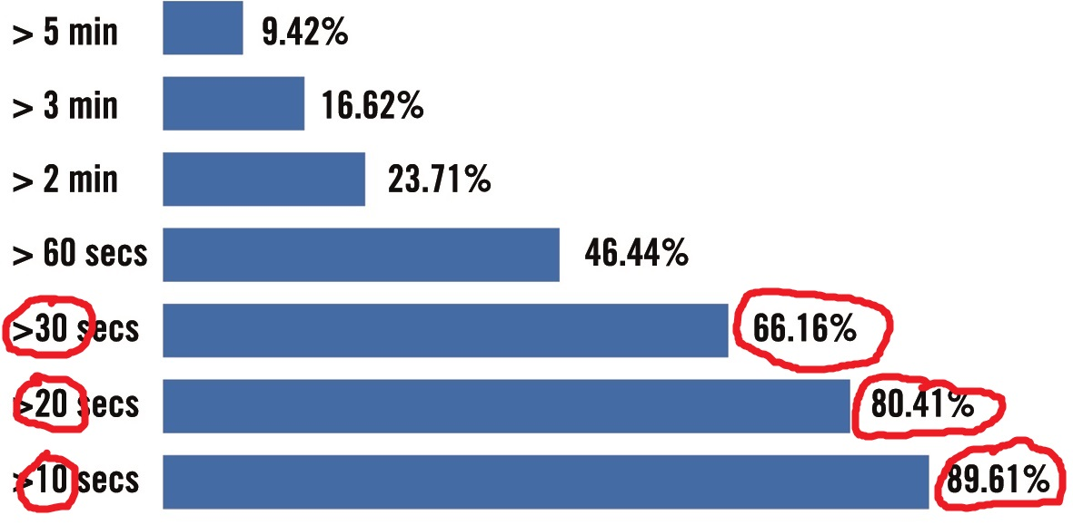
How much video is typically watched?
Notes:
Video is the biggest growing platform in social media
9 out of 10 browsers will look at a 10 second video of their interest
1 out of 10 will watch a 5 minute video of their interest
(Tubemogul Video Marketer, 2014)

Slide 13
Notes:
We plan to link in with videos under the umbrella theme of mindful change
From short enticing, videos branching into 1 min videos.
The ACT consistent ones will be labelled accordingly

Slide 14
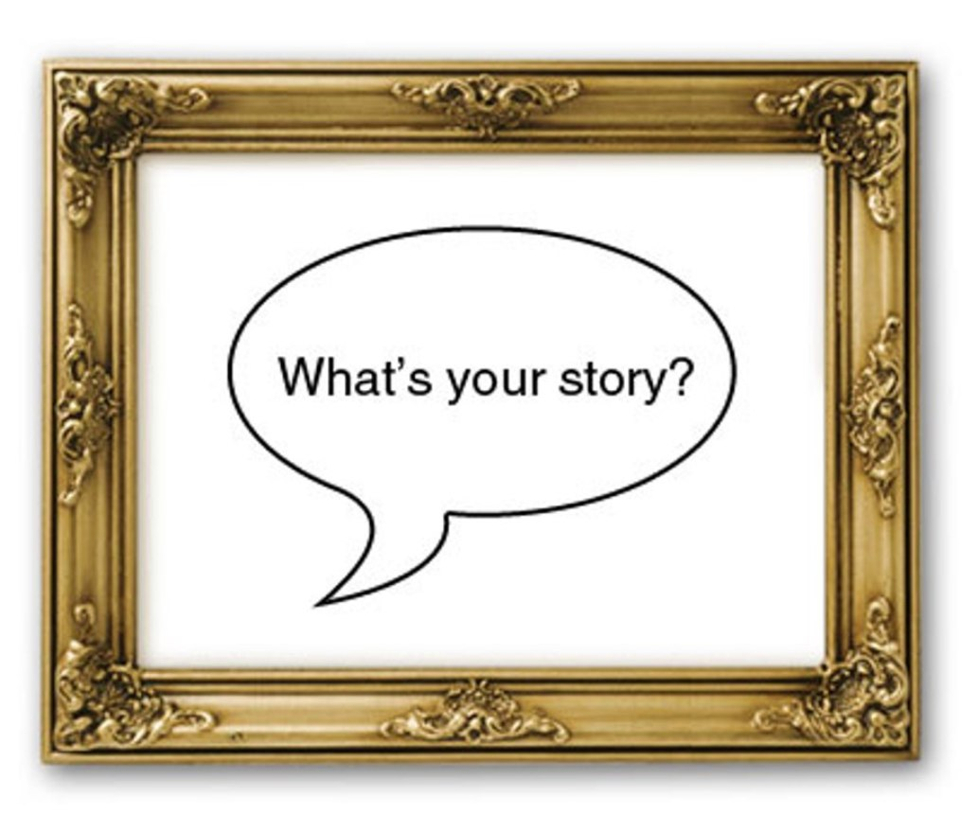
Notes:
If you want to entice people – do it through STORY
Massive amounts of evidence – not just in social media
Companies and businesses are now capitalising on STORIFYING

Slide 15
Why STORY?
Notes:
Research shows that
A catchy story generates FEELINGS – pleasant and unpleasant

Slide 16
Notes:
Your STRUGGLE and your SOLUTION is what captivates people
Ultimately what works is showing that you’re HUMAN – this is what ACBS is all about

Slide 17
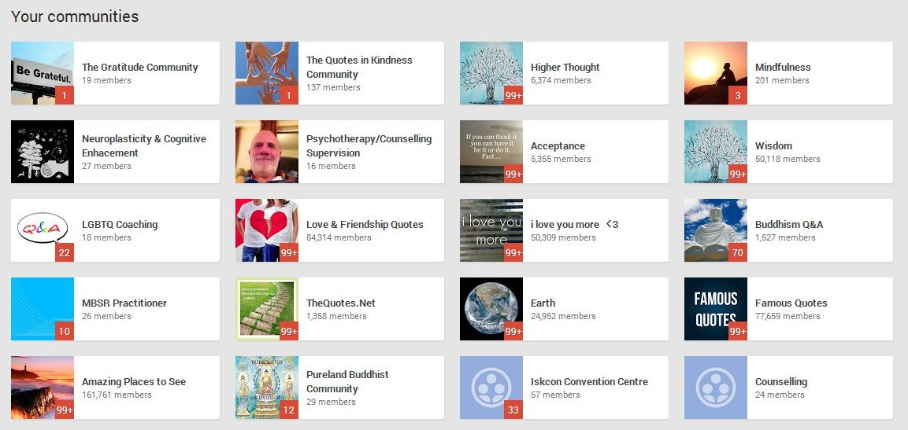
Notes:
From here you can provide links for other avenues, such as communities, pages etc.
These can then empower others to choose and explore their own avenues

Slide 18
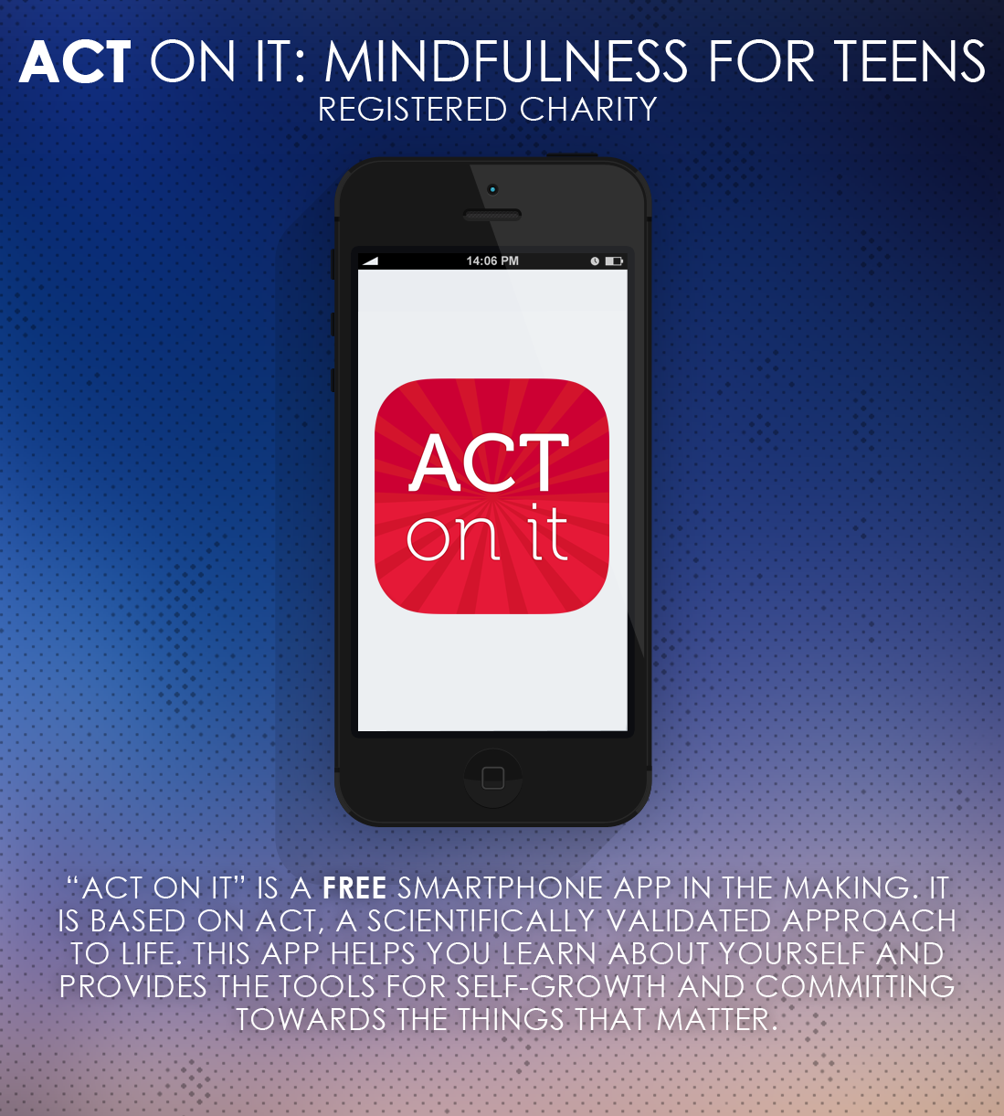
Notes:
And then… on to things like apps…
Our pending project, FREE and to be available on all smartphones and tablet devices

Slide 19
Notes:
Im currently working on the content for this alongside some keen ACT folks from ACBS
We’re in discussions at present about research testing.

Slide 20
info@mindfulcreation.com

